Slide 1



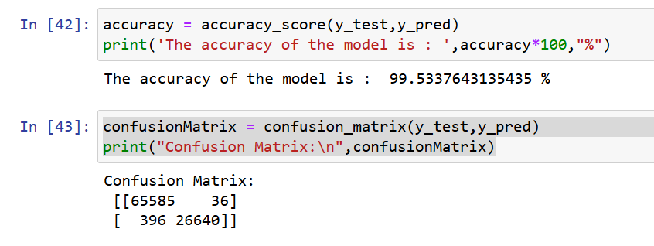
Project Name
Program Feedback
Project Short Summary
Best Program I have everattended with complete Explanation from Groundup and Detailed Attention to students.
A Random Forest Classifier effectively predicts 10-year coronary heart disease risk, showing strong performance metrics despite challenges like data imbalance and feature engineering. Its accuracy supports early diagnosis and preventive healthcare. Further enhancements could boost predictive capabilities, crucial for managing CHD risk and public health improvement.
Final Project Outcome Screenshot
Adarsh Agrawal
adarshagrawalSGSITS@gmail.com
Shri Govindram Sekhsariya Institute of Technology and Science
#skillsbuild

